Slide 1
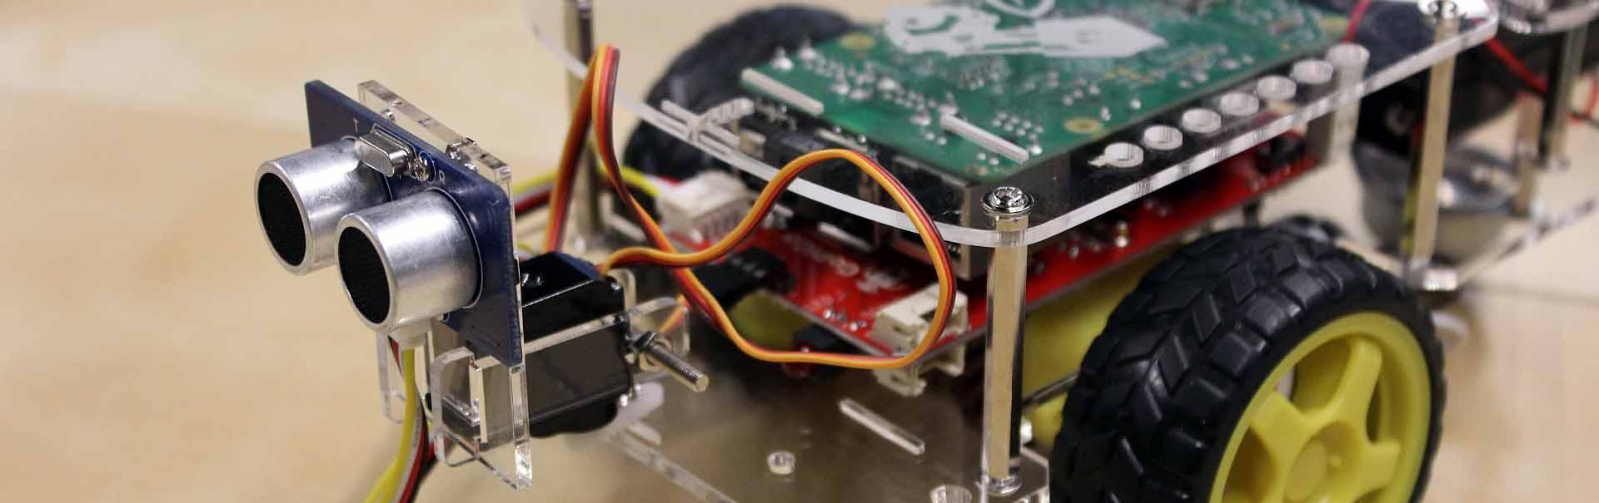
GoPiGo Box Locator
Group members: Eric Clifford, Ernest martin, Phillip pappan, Ray thibodeaux

Slide 2
Problems / Goal
A simple obstacle avoider/locator in the form of a box locator can serve many purposes, from being an underlying component for simple, interactive games, to helping improve the efficiency and effectiveness of business operations.
Some children often have a difficult time interacting with others. A GoPiGo can be a useful and interactive tool for children who are typically reserved. Therefore, we can develop a program or game which allows the child to use the robot in an interactive way. With an obstacle avoider/locator, this can be as simple as an object-finding game, as complex as a maze-solving game, and more.

Slide 3
Problems / Goal
When dealing with large organizations, such as UPS, FedEx, and USPS, package organization is key to operational success. When boxes are misplaced, packages get sent to the wrong address, get stuck in transit for longer than necessary, or worse, go into a big black hole never to be seen again. All of these scenarios have something in common, they cut into the bottom line. Most of these companies have policies in place that state if a package doesn’t arrive on time, shipping fees will be refunded.
Our goal for this project is to begin the steps of creating a piece of technology that could solve some of these problems, by turning our GoPiGo into an automated object locator. Hopefully, that location data could then be used by other technologies to identify the objects, and even move them to the appropriate places. This would allow for nearly unlimited application in both business and entertainment settings.

Slide 4
Objectives
Design a program which will allow a GoPiGo to locate multiple boxes along a path. Locate the boxes in the quickest time possible. Time is money.
Avoid any possible collisions.
Structure program in a way that allows for the future addition of components, such as more complex interaction, added gaming functionality, or a bar code readers to utilize the box locations.
Open the door for interaction between children and the GoPiGo, in the form of responsive programming.

Slide 5


Solutions

Slide 6
Alternative solutions
Solution 1: Car scans left and right and then moves forward a distance that is equal to the average length of a box. If a box is found, that information is made available to the user. This process repeats until the end of the route is reached.
Solution 2: The car moves in a continuous manner, while simultaneously scanning for boxes at a rightward diagonal position, followed by a forward position. If a box is detected the car will stop in front of the detected box and that box location will be made available for use. If the end of the route is reached, the car turns around to scan for boxes on its other side.

Slide 7
Solution 1
PROS:
CONS:
Simpler to develop
Car has to make only one pass down its route
Less resource intensive
Car only moves an average box length at a time before stopping to scan
The further apart boxes are, the more time that is wasted scanning empty space. This could lead to this solution being significantly slower than solution 2
Dependent on boxes being a certain average length. If a box length is significantly bigger or smaller than the average box length, boxes could be double counted or missed
Doesn’t account for stacked boxes or objects other than boxes

Slide 8
Solution 2
PROS:
CONS:
Much more adaptable to changing variables, such as box length
Car moves continuously, only stopping beside a detected box and to turn around
Potentially significantly quicker than Solution 1 if the boxes are, on average, distanced further than a box length apart
Possibility of using 2 cars to cover both sides simultaneously, and eliminating the turnaround function, improving scan time.
More complex to implement
Slightly more resource intensive
Car must make two passes down its route
Doesn’t account for stacked boxes
Runs the risk of finding objects that aren’t boxes

Slide 9

Decision

Slide 10
Decision: Solution 2
Although slightly more complex and resource intensive, solution 2 seems to be the better of the two solutions.
The pros from using solution 2, in the form of time saved, far outweigh its cons.
Solution 1 is overall less adaptable to certain scenarios that could arise. For example, if boxes are spaced apart by a considerable amount on average, the car will spend an unnecessary amount of time stopping to scan empty space. Also, being reliant on an average box length isn’t the best. Boxes, such as the ones used by shippers, can vary significantly in length.

Slide 11


DESIGN

Slide 12
Features / operations
Scan for boxes in a single direction while moving forward continuously
Approach each box and output a “Found” message when located
Turn around and scan for boxes on the other side
Count total number of boxes found

Slide 13
Process Diagram

Slide 14
Pseudocode

Slide 15


Progress

Slide 16
Resources Needed
GoPiGo with Raspberry Pi
Ultrasonic Sensor
Objects to locate (Boxes)
Functional program to run
Users

Slide 17
Functional Requirements

Slide 18
Initial user requirements

Slide 19
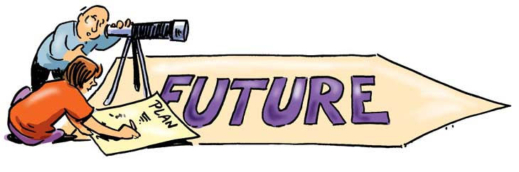
Future plans / ideas

Slide 20
Future plans / Ideas
Create an interactive game that makes use of the program’s functionality
Solve object identification and stacked object issues
Integrate a barcode scanner for object identification
Improve obstacle avoider to create a pathfinder/maze solver
Allow for two GoPiGo cars to scan either side simultaneously

